Slide 1


Enabling Self-service Data Provisioning through Semantic Enrichment of Data
me@ahmadassaf.com @ahmadaassaf
Ahmad Assaf
Supervisors: Raphaël Troncy and Aline Senart
Enabling Self-service Data Provisioning Through Semantic Enrichment of Data
18th December 2015

Slide 2
Outline
Introduction
Use-case Scenario
Research Challenges
Contributions
Towards A Complete Dataset Profile
Harmonized Dataset Model (HDL)
Automatic generation and validation of dataset profiles (Roomba)
Objective quality assessment
Towards Enriched Enterprise Data
Semantic enrichment in the enterprise
Semantic Social News Aggregator (SNARC)
Conclusion & Future Work
Publications
Enabling Self-service Data Provisioning Through Semantic Enrichment of Data

Slide 3

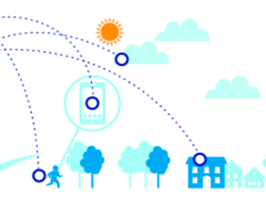
Introduction | What is Business Intelligence ?
Enabling Self-service Data Provisioning Through Semantic Enrichment of Data
Notes:
Enterprises use a wide range of heterogeneous information systems in their business activities such as Enterprise Resource Planning (ERP), Customer Relationships Management (CRM) and Supply Chain Management (SCM) systems

Slide 4
Introduction | Self-service Data Provisioning
Preparing and gathering data for reporting and visualization is by far the most challenging task in most BI projects large and small
Self-service data provisioning aims at reducing the challenge by providing dataset discovery, acquisition and integration techniques intuitively to the end user
Enabling Self-service Data Provisioning Through Semantic Enrichment of Data

Slide 5
Use-case Scenario - Personas
Dan FERRY
Paul PARKER
Paris, France
London, UK
Data Analyst
Data Portal Administrator
Ministry of Transport
data.gov.uk
I collect and acquire #data from multiple data sources, filter and clean data, interpret and analyze results and provide ongoing reports
I monitor the overall health of the portal. Also oversee the creation of users, organizations and datasets
Yesterday
2 days ago
I try to ensure a certain #dataQuality level by continuously checking for spam and manually enhancing dataset descriptions and annotations
J’adore #SAP #Lumira #dashboard #visualization #BI http://go.sap.com/product/analytics/lumira.html
3 days ago
1 week ago
Enabling Self-service Data Provisioning Through Semantic Enrichment of Data
Notes:
SAP Lumira a self-service data visualization tool that makes it easy to import data from multiple sources, perform visual BI analysis using intuitive dashboards, interactive maps, charts, and infographics

Slide 6
Dan receives a memo from his management to create a report comparing the number of car accidents that occurred in France for this year, to its counterpart in the United Kingdom (UK)
Dan is asked to highlight accidents related to illegal consumption of alcohol in both countries
Use-case Scenario
Enabling Self-service Data Provisioning Through Semantic Enrichment of Data
Notes:
After examining the ministry's records, Dan is able to collect the data needed to create his report for the French side. Dan also issues an official request to the Department of Transport in UK to collect the data needed. However, Dan knows that the process takes a long time and his management needs the report within days. Dan is familiar with the Open Data movement and starts his journey searching through different data portals in the UK.
add paul here

Slide 7
Research Challenges [1/2]
Find useful datasets for specialized domains
Quickly assess datasets by checking the attached metadata
Generate and validate datasets descriptions and metadata
Detect spam and irrelevant datasets
Dataset Maintenance & Discovery
Dataset Quality
Automatic tools to issue scores or certificates reflecting the objective dataset quality
Check if the dataset on hand is of a certain degree of quality to be used in reports
Enabling Self-service Data Provisioning Through Semantic Enrichment of Data
Notes:
relate the challenges to the personas
Provide examples
add colors coding as well

Slide 8
Research Challenges [2/2]
Map and organize the data in order to have a unified view for these heterogeneous and complex data structures
Assess which entity’s properties are more important than others for particular tasks
The vast amount of data available in social networks makes it hard to spot what is relevant in a timely manner
Dataset Integration and Enrichment
Enabling Self-service Data Provisioning Through Semantic Enrichment of Data

Slide 9
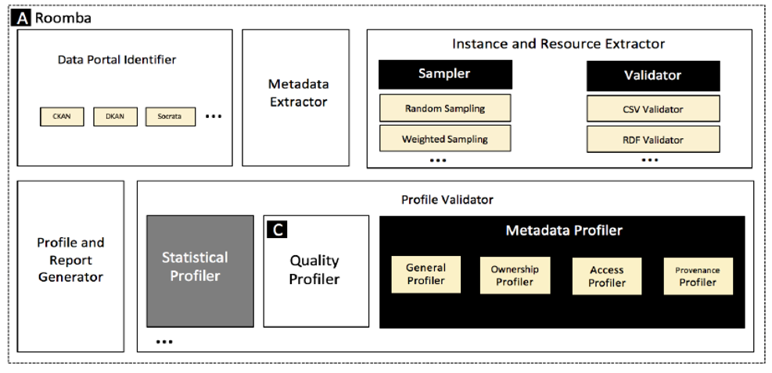
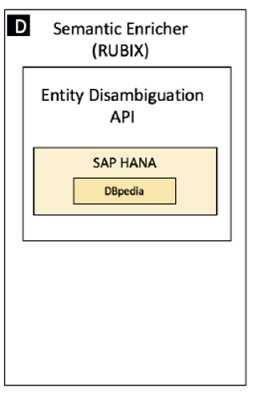
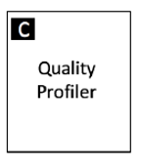
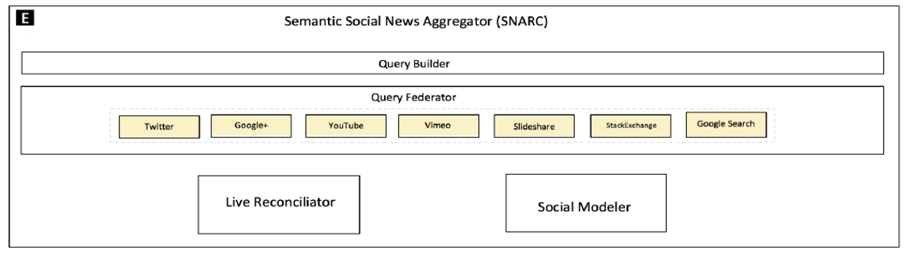
Proposed Framework
Dataset Maintenance & Discovery
HDL
Roomba
Dataset Quality
Dataset Integration and Enrichment
RUBIX
SNARC
Enabling Self-service Data Provisioning Through Semantic Enrichment of Data

Slide 10
PART I
Towards A Complete Dataset Profile
Research Challenges
Dataset Maintenance & Discovery
Dataset Quality
Enabling Self-service Data Provisioning Through Semantic Enrichment of Data
Notes:
Remind the audience with the problem here

Slide 11
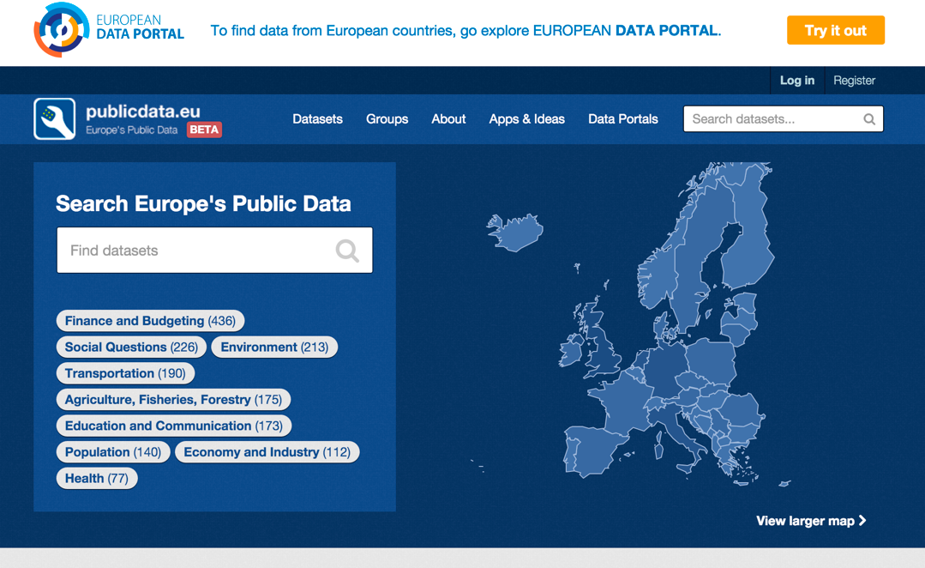
Data Portals/Data Management Systems
Metadata is structured information that describes, explains, locates or otherwise makes it easier to retrieve use or manage information resources
Entry points to discover published datasets
Curated collection of datasets metadata providing a set discovery and integration services
Built on top of Data Management Systems (DMS) like CKAN, DKAN and Socrata
Enabling Self-service Data Provisioning Through Semantic Enrichment of Data

Slide 12


Dataset Vocabularies & Models
Data Catalog Vocabulary (DCAT)
Three main classes: dcat:Catalog, dcat:Dataset and dcat:Distribution
Extensions : DCAT-AP, The Asset Description Metadata Schema (ADMS)
Vocabulary of Interlinked Datasets (VoID)
Three main classes: void:Dataset, void:Linkset and void:subset
+ links between datasets
Enabling Self-service Data Provisioning Through Semantic Enrichment of Data

Slide 13
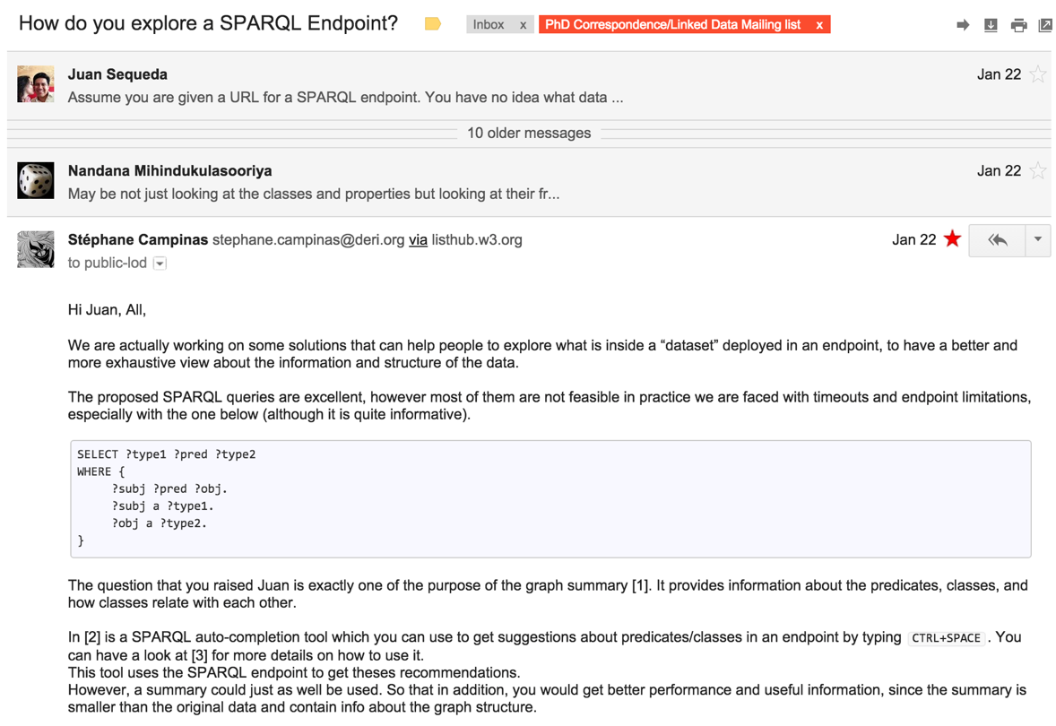
Why a Harmonized Model ?
Exploring/discovering datasets for (re)use
Defining a “minimal” set of information needed to build a “profile”
Building tools that will automatically generate/validate metadata models
Enabling Self-service Data Provisioning Through Semantic Enrichment of Data

Slide 14
Metadata Model Classification | Information groups
A dataset can contain four main Information groups:
Resource
Actual raw data e.g. JSON, CSV, SPARQL endpoint
Tag
Descriptive knowledge: simple textual tags, semantically rich controlled terms
Causalities, roads, roadsafety, accidents
Group
Organizational units that share common semantics, a cluster or curation based on shared themes/categories
Health, Travel and Transport
Organization
Clustering or curation solely based on associations with specific administration parties
Department for Transport, Ministère de l’Écologie
Enabling Self-service Data Provisioning Through Semantic Enrichment of Data

Slide 15
Metadata Model Classification | Information types
A dataset can contain the following information types:
Resource
Tag
Organization
Group
General information
Statistical information
title, description, id
max_value, uniques, average
Quality information
Access information
rating, availability, freshness
URL, license_title, license_id
Ownership information
Geospatial information
author, maintainer_email
bbox, layers
Provenance information
Temporal information
version, creation_date, update_date
coverage_from, coverage_to
Enabling Self-service Data Provisioning Through Semantic Enrichment of Data

Slide 16
Mapping Datasets Models | Information groups
1
Map the information groups [resource, tag, group, organization]
Resource
Tag
Group
Organization
CKAN | DKAN | POD | DCAT | VoID | Schema.org | Socrata
resources | resources | distribution | Dcat:Distribution | Void:Dataset →void:dataDump | Dataset:distribution | attachments
tags | tags | keyword | Dcat:Dataset → :keyword | Void:Dataset → :keyword | creativeWork:keywords | tags
Enabling Self-service Data Provisioning Through Semantic Enrichment of Data

Slide 17
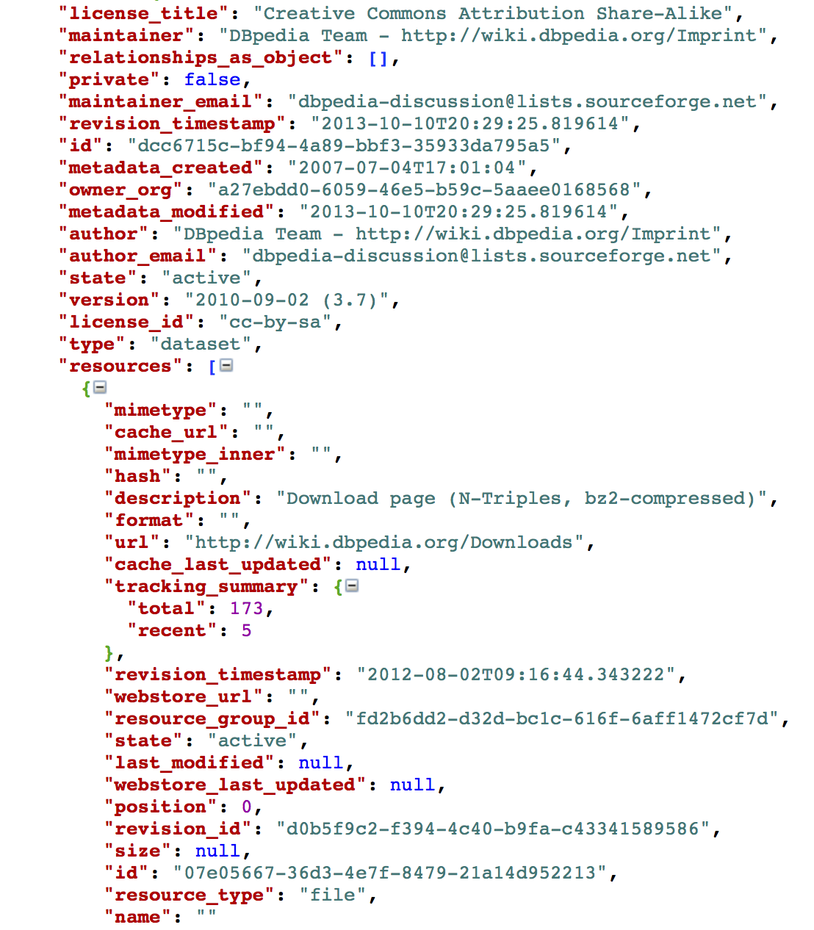
Mapping Datasets Models | Information types
2
Map the information types [general, ownership, provenance, etc.]
CKAN
maintainer_email
DKAN
maintainer_email
POD
ContactPoint -> hasEmail
DCAT
dcat:Dataset -> dct:creator -> foaf:Person:mbox
VoID
void:Dataset -> dct:creator -> foaf:Person:mbox
Schema.org
CreativeWork:producer -> Person:email
Enabling Self-service Data Provisioning Through Semantic Enrichment of Data
17

Slide 18
Harmonized Dataset Model (HDL)
There is an abundance of extensions and application profiles that try to fill in those gaps, but they are usually domain specific addressing specific issues like geographic or temporal information
HDL
5 Classes
61 properties
+ 3 Controlled field values
resource_type: direct, accessible_bitstream, file.upload, api,
visualization, code, documentation
Enabling Self-service Data Provisioning Through Semantic Enrichment of Data
Notes:
There is an abundance of extensions and application profiles that try to fill in those gaps, but they are usually domain specific addressing specific issues like geographic or temporal information

Slide 19
Flashback | Revisiting Scenario
Paul knows what are the major dataset models out there, and what kind of metadata data owners need to fully represent their dataset
Paul will be able to use HDL as a basis to extend and present the datasets he controls
Paul can use HDL and the proposed mappings as a basis to extend Roomba to support various dataset models like DKAN or Socrata
Dan will be able to make fast decisions whether the dataset examined is suitable or not by examining the rich datasets metadata presented in HDL
Enabling Self-service Data Provisioning Through Semantic Enrichment of Data

Slide 20
Proposed Framework
Dataset Maintenance & Discovery
HDL
Enabling Self-service Data Provisioning Through Semantic Enrichment of Data

Slide 21
Dataset Profiling
Data profiling is the process of creating descriptive information and collect statistics about that data. It is a cardinal activity when facing an unfamiliar dataset
Profiles reflect the importance of datasets without the need for detailed inspection of the raw data
Statistical Profiling
[Abedjan 2014 , Makela 2014]
Topical Profiling
[Bohm 2012, Fetahu 2014]
Metadata Profiling
Enabling Self-service Data Provisioning Through Semantic Enrichment of Data
Notes:
There is an abundance of extensions and application profiles that try to fill in those gaps, but they are usually domain specific addressing specific issues like geographic or temporal information

Slide 22
Metadata Profiling | Related Work
Flemming’s data quality assessment tool provides metadata assessment based on manual user input [Flemming 2010]
ODI certificate provides descriptions of the published data quality in plain English based on an extensive survey filled by the publisher
Project Open Data Dashboard tracks and measures how US governments implement Open Data principles
The Datahub Validator gives an overview of data sources cataloged on The Datahub
*
**
***
* https://certificates.theodi.org/en/
** https://project-open-data.cio.gov/
*** http://validator.lod-cloud.net/
Enabling Self-service Data Provisioning Through Semantic Enrichment of Data
Notes:
Flemming 2010
Zaveri 2012
Berners-Lee 2006
Kontokostas 2014
Ruckhaus 2014
Cherix 2014

Slide 23
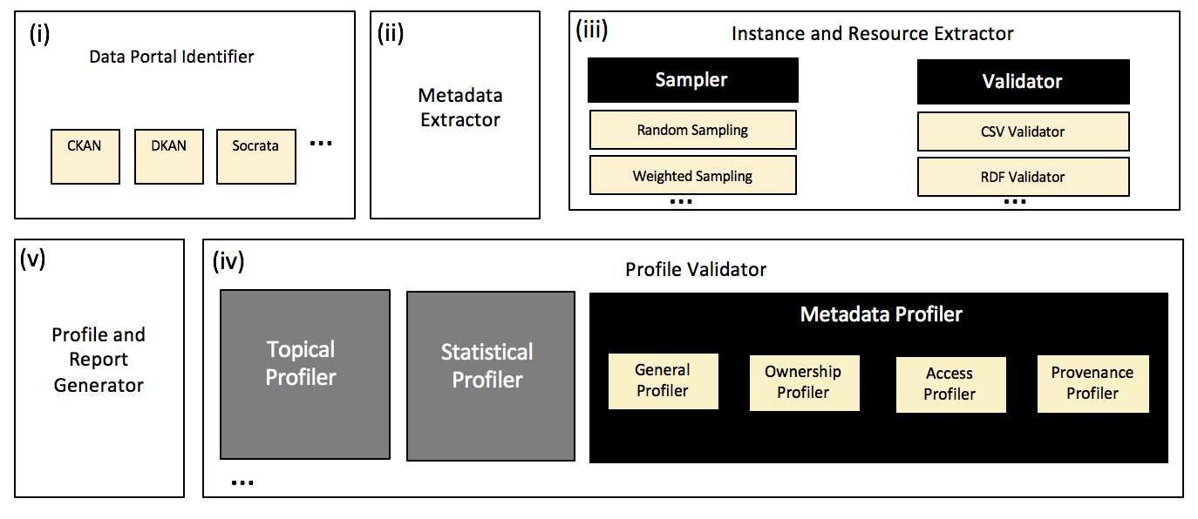
Roomba | An Extensible Pipeline to Generate and Validate Profiles
https://github.com/ahmadassaf/opendata-checker/
Enabling Self-service Data Provisioning Through Semantic Enrichment of Data
Notes:
Say Roomba instead of we
Stress that its open source tool at the second line

Slide 24

Notes:
Lightweight reconcilation on the licence values
While hdl do alignment on property name .. Roomba does that as well on the values

Slide 25
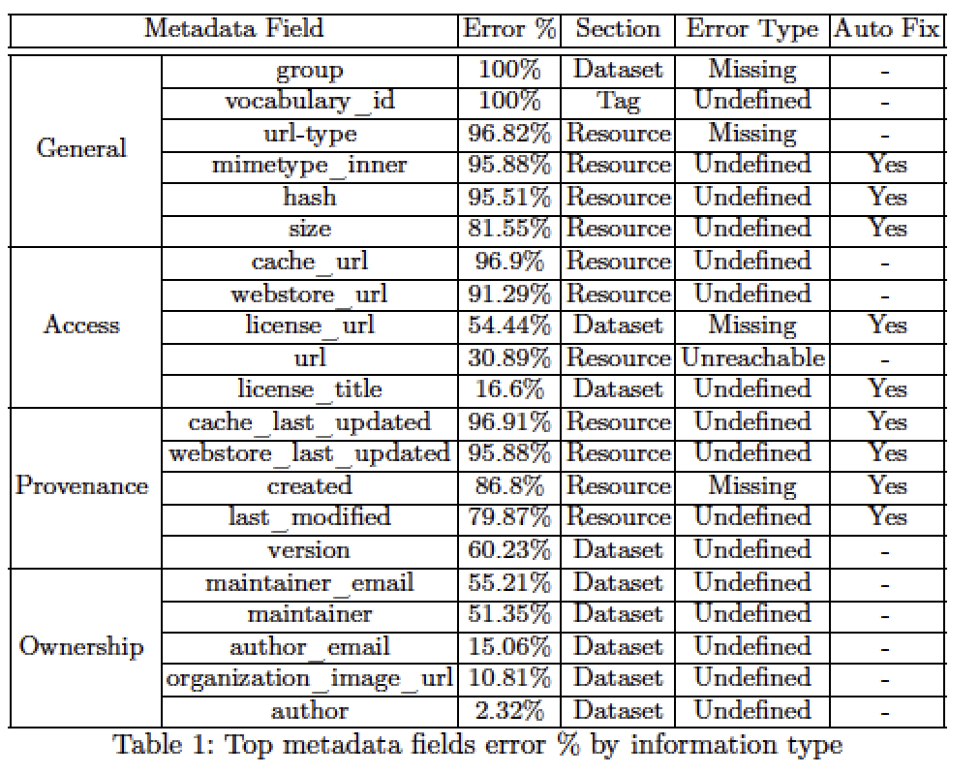
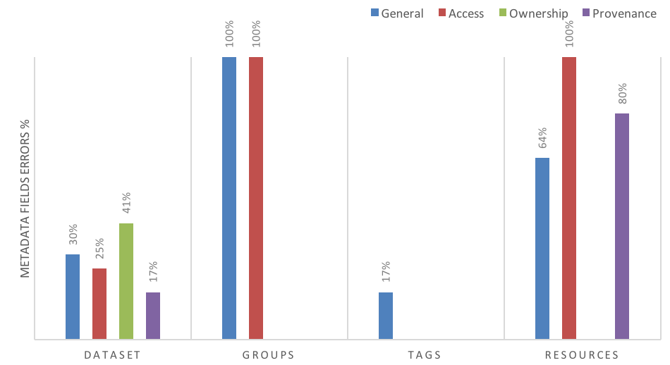
LOD Cloud State | Top Metadata Errors
Enabling Self-service Data Provisioning Through Semantic Enrichment of Data
Notes:
19% of these errors are fixed automatically
33.33% can be fixed automatically by tools plugged into the data publishing workflow

Slide 26
Flashback | Revisiting Scenario
Paul can use Roomba to automatically fix datasets metadata issues, and notify the datasets owners of the other issues to be manually fixed
Paul will be able now to identify spam datasets. In addition to that, data available in his portal will now have rich semantic information attached to it
Dan will be able to have direct access to rich and high-quality dataset descriptions generated by Roomba
Enabling Self-service Data Provisioning Through Semantic Enrichment of Data
Notes:
stress on spam
Dan benefit from the correction that roomba is doing

Slide 27
Proposed Framework
Dataset Maintenance & Discovery
HDL
Roomba
Enabling Self-service Data Provisioning Through Semantic Enrichment of Data

Slide 28
Objective Data Quality Assessment
Data quality assessment is the process of evaluating if a piece of data meets the consumers need in a specific use case
In [Zaveri 2012] lots of the defined quality dimensions are not objective e.g., like low latency, high throughput or scalability
In addition, there were some missing objective indicators vital to the quality of LOD e.g., indication of the openness of the dataset
We propose an objective framework to evaluate the quality of Linked Data sources.
Enabling Self-service Data Provisioning Through Semantic Enrichment of Data
Notes:
Flemming 2010
Zaveri 2012
Berners-Lee 2006
Kontokostas 2014
Ruckhaus 2014
Cherix 2014

Slide 29
Objective Data Quality Assessment
10 Quality Measures
Availability
Licensing
Freshness
64 Quality Indicators
Check the resources format field for meta/void value
Check the format and mimetype fields for resources
Check if the content-type extracted from the a valid HTTP request is equal to the corresponding mimetype field
Check if there is at least one resource with a format value corresponding to one of example/rdf+xml, example/turtle, example/ntriples, example/x-quads, example/rdfa, example/x-trig
Enabling Self-service Data Provisioning Through Semantic Enrichment of Data

Slide 30
Objective Data Quality Assessment Tools
Large amount of those indicators can be examined automatically from attached datasets metadata found in data portals Extensive survey on Linked Data quality tools
Models and ontologies quality covered in the literature [Kontokostas 2014, Ruckhaus 2014, Cherix 2014]
Lack in automatic tools to check the dataset quality especially in its completeness, licensing and provenance measures
Enabling Self-service Data Provisioning Through Semantic Enrichment of Data

Slide 31
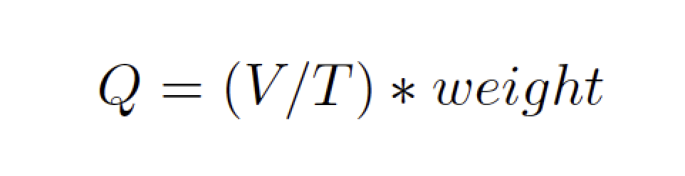
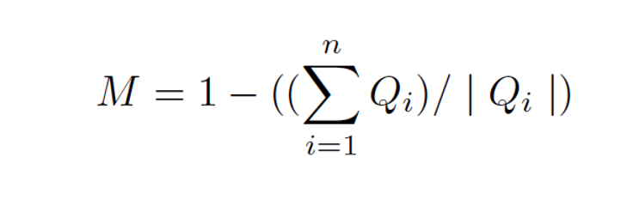
Quality Score Calculation
The quality indicator score is an error ratio based on a ratio between the number of violations V and the total number of instances where the rule applies T multiplied by the specified weight for that indicator
A quality measure score should reflect the alignment of the dataset with respect to the quality indicators
The quality measure score M is calculated by dividing the weighted quality indicator scores sum by the total number of instances in its context
Enabling Self-service Data Provisioning Through Semantic Enrichment of Data
Notes:
put examples

Slide 32
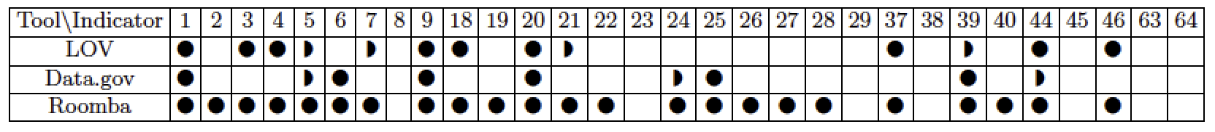
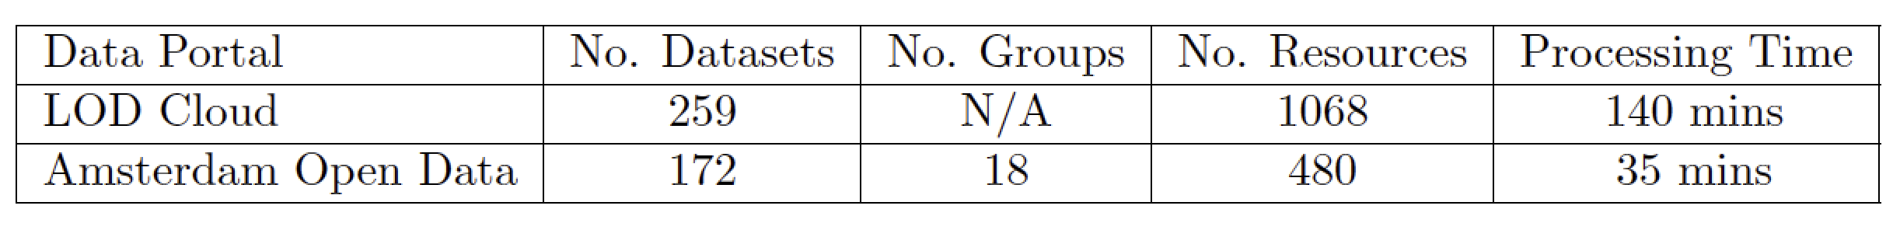
Roomba Experiments & Evaluation
Profiling correctness and completeness
To analyze the completeness, we manually constructed a synthetic set of profiles
Incorrect resources mimtype or size
Invalid number of tags or resources
Correct normalization of license information: license_id or license_title
Syntactically invalid emails and urls : author_email or maintainer_email
Enabling Self-service Data Provisioning Through Semantic Enrichment of Data

Slide 33
Flashback | Revisiting Scenario, Proposed Framework
Dataset Maintenance & Discovery
HDL
Roomba
Dataset Quality
Paul will be able now to identify low quality datasets
Paul will be able to generate a quality score for his datasets
Dan will be able to have access to cleaner, richer set of datasets
Enabling Self-service Data Provisioning Through Semantic Enrichment of Data

Slide 34
PART II
Towards Enriched Enterprise Data
Research Challenges
Dataset Integration and Enrichment
Enabling Self-service Data Provisioning Through Semantic Enrichment of Data
Notes:
break .. make proper transition
remind the context for the need of data enrichment and integration
explain always why we need this -> justification

Slide 35
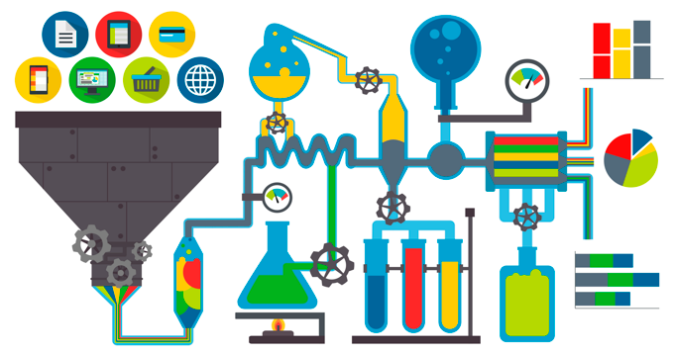
Enterprise Knowledge Base Services
Search service (ranked, contextual)
Entities and properties recommendation
Enhancing schema matching
Enabling Self-service Data Provisioning Through Semantic Enrichment of Data
Notes:
why we need a KB ?
explain what is SAP HANA
explain KB in HANA
Make it more visual
Focuses on the services the enterprise need

Slide 36
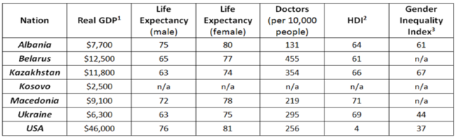
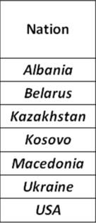
Data Enrichment
Annotates datasets based on the semantics of the data at the instance level
We represent each instance at the cell level with a set of types retrieved from our service
The column is represented now as a vector of rich types and their corresponding confidence
Select the most common type to annotate and label the column
PL_C
PL_C
PL_C
country:87,3212, music album:12,331,Order of Chivalry:11,2321
……
…….
Enabling Self-service Data Provisioning Through Semantic Enrichment of Data

Slide 37
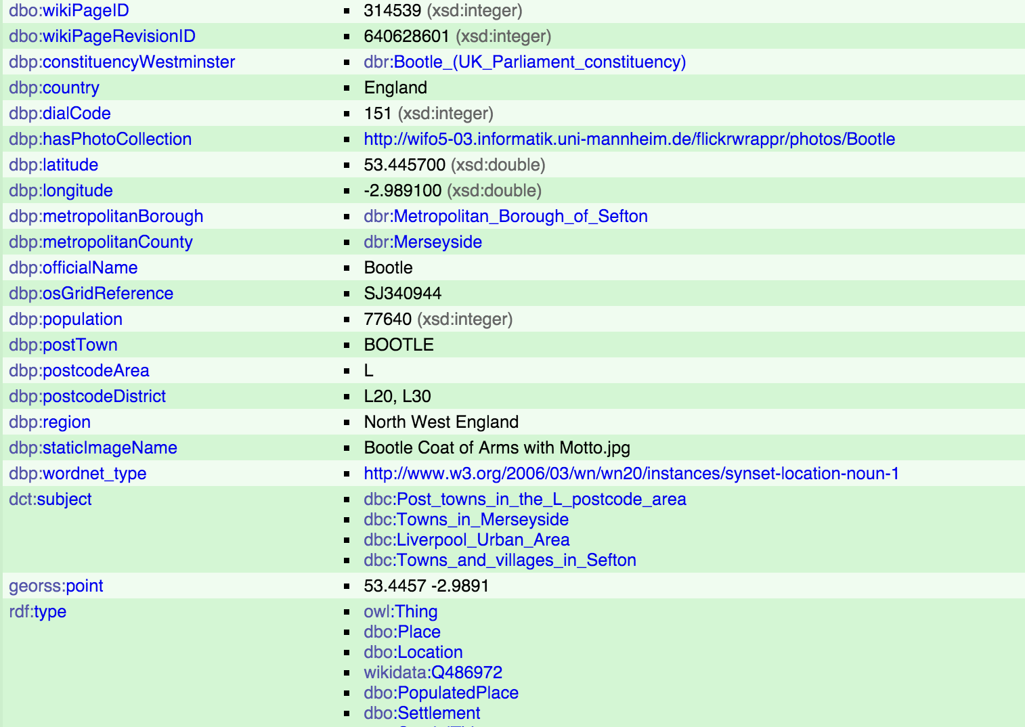
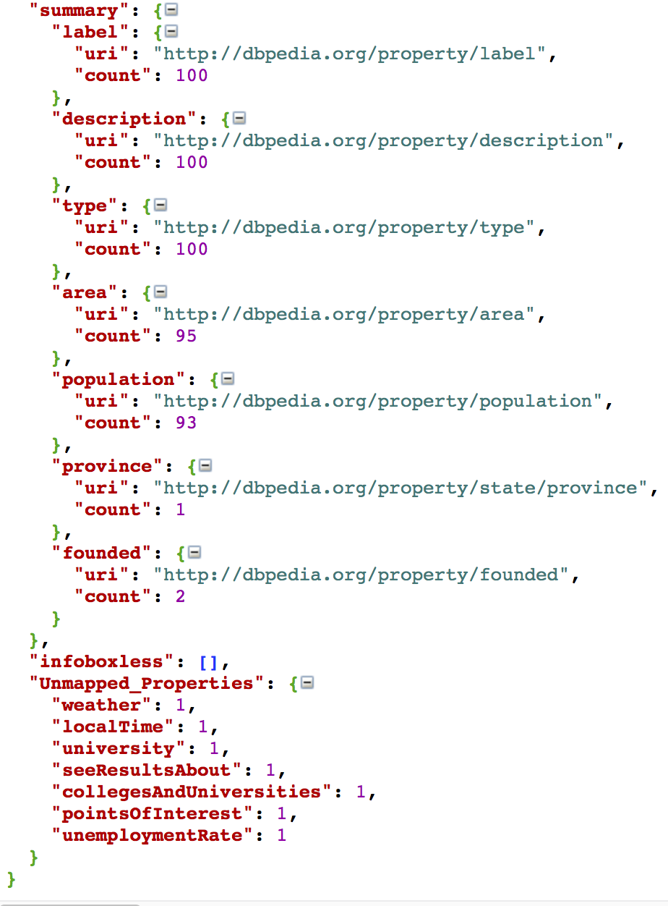
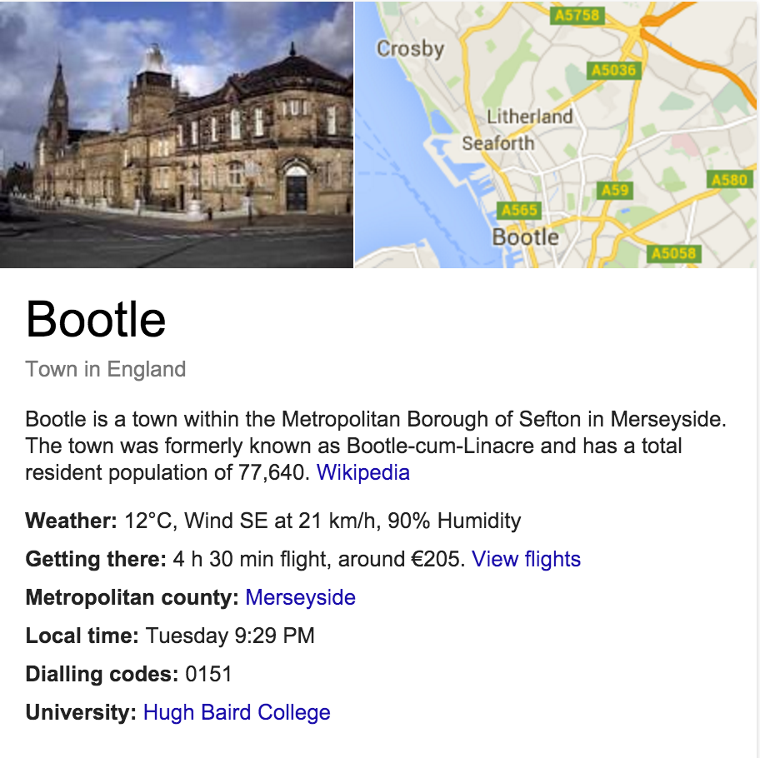
Data Enrichment | Properties Ranking
Enabling Self-service Data Provisioning Through Semantic Enrichment of Data

Slide 38
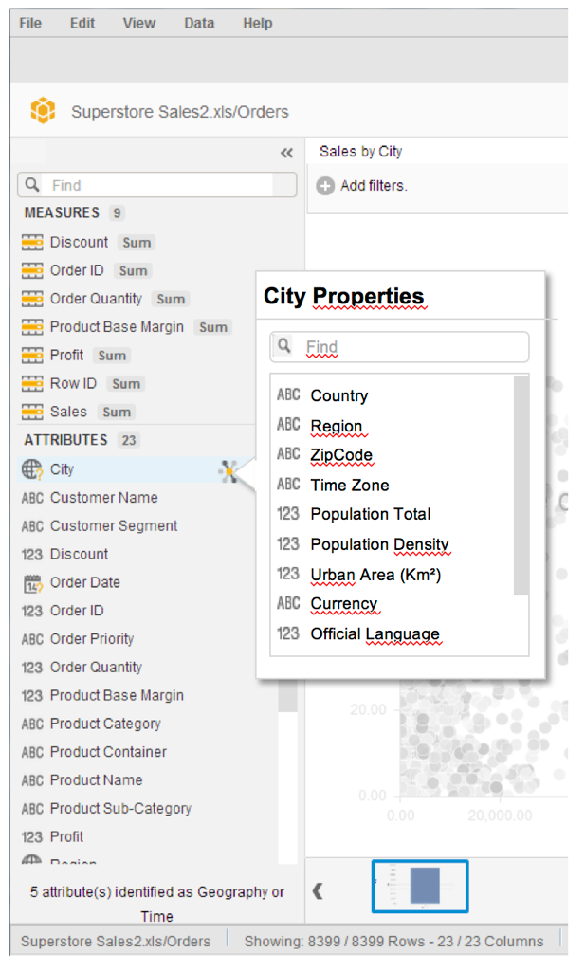
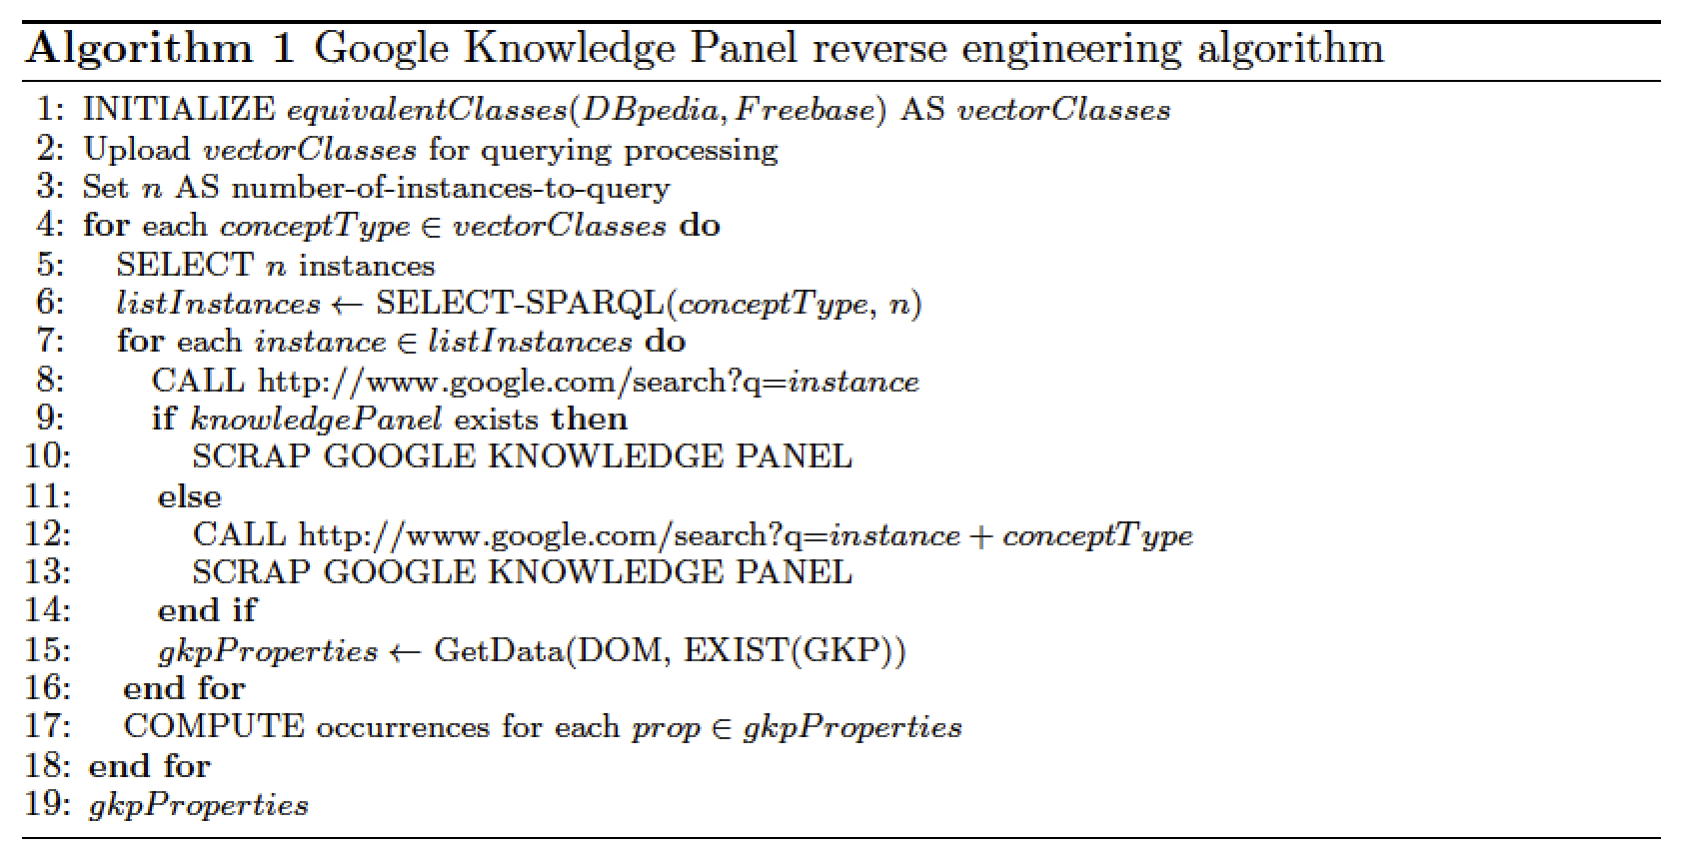
Data Enrichment | Properties Ranking
Enabling Self-service Data Provisioning Through Semantic Enrichment of Data

Slide 39
Improving Schema Matching
Added the semantic matching to the Auto Mapping Core (AMC)
Evaluated against data coming from two SAP systems: The Event Tracker and Travel Expense Manager
Increased the overall confidence score with an average of 11% and the number of valid matches found with an average of 10%
Enabling Self-service Data Provisioning Through Semantic Enrichment of Data
Notes:
Comma++

Slide 40
Flashback | Revisiting Scenario
Dan now has access to various datasets that he found matching his query to the portal administered by Paul
Having imported those dataset into Lumira, Dan will be also able to use the internal knowledge base to apply various semantic enrichments on this data
Dan will be also able to use the schema matching services to find and merge those datasets in his reports
Dan will be able to annotate and enrich his reports with external data
Enabling Self-service Data Provisioning Through Semantic Enrichment of Data

Slide 41
Proposed Framework
Dataset Integration and Enrichment
RUBIX
Enabling Self-service Data Provisioning Through Semantic Enrichment of Data

Slide 42
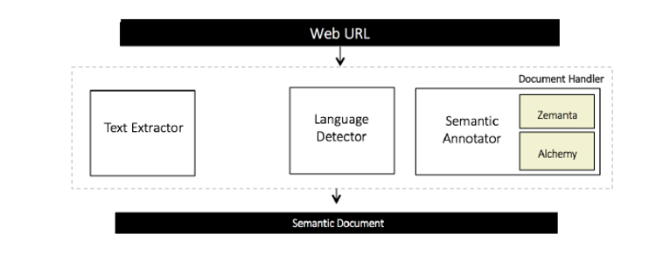
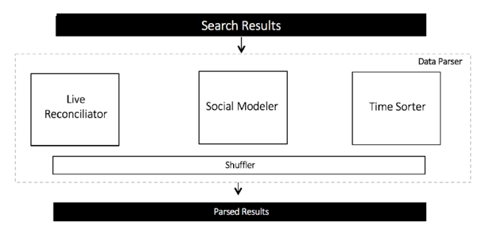
Semantic Social News Aggregation | SNARC
SNARC is a service that extracts the semantic context of documents in order to recommend related content from the web and social media
Enabling Self-service Data Provisioning Through Semantic Enrichment of Data

Slide 43
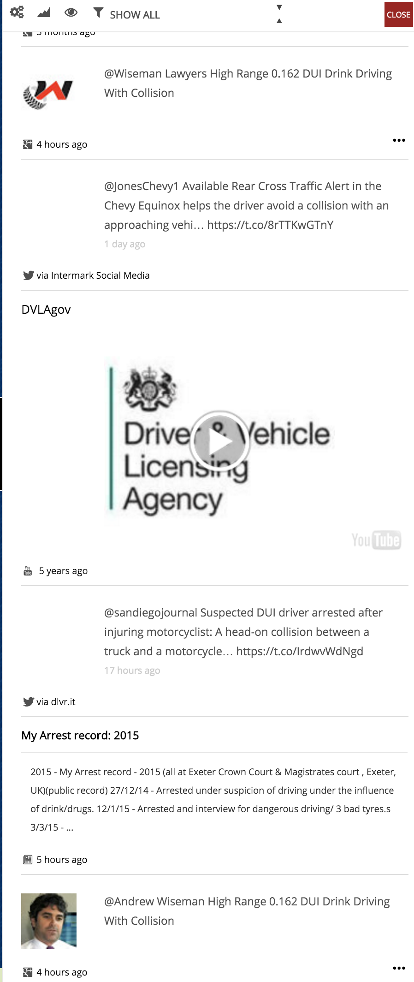
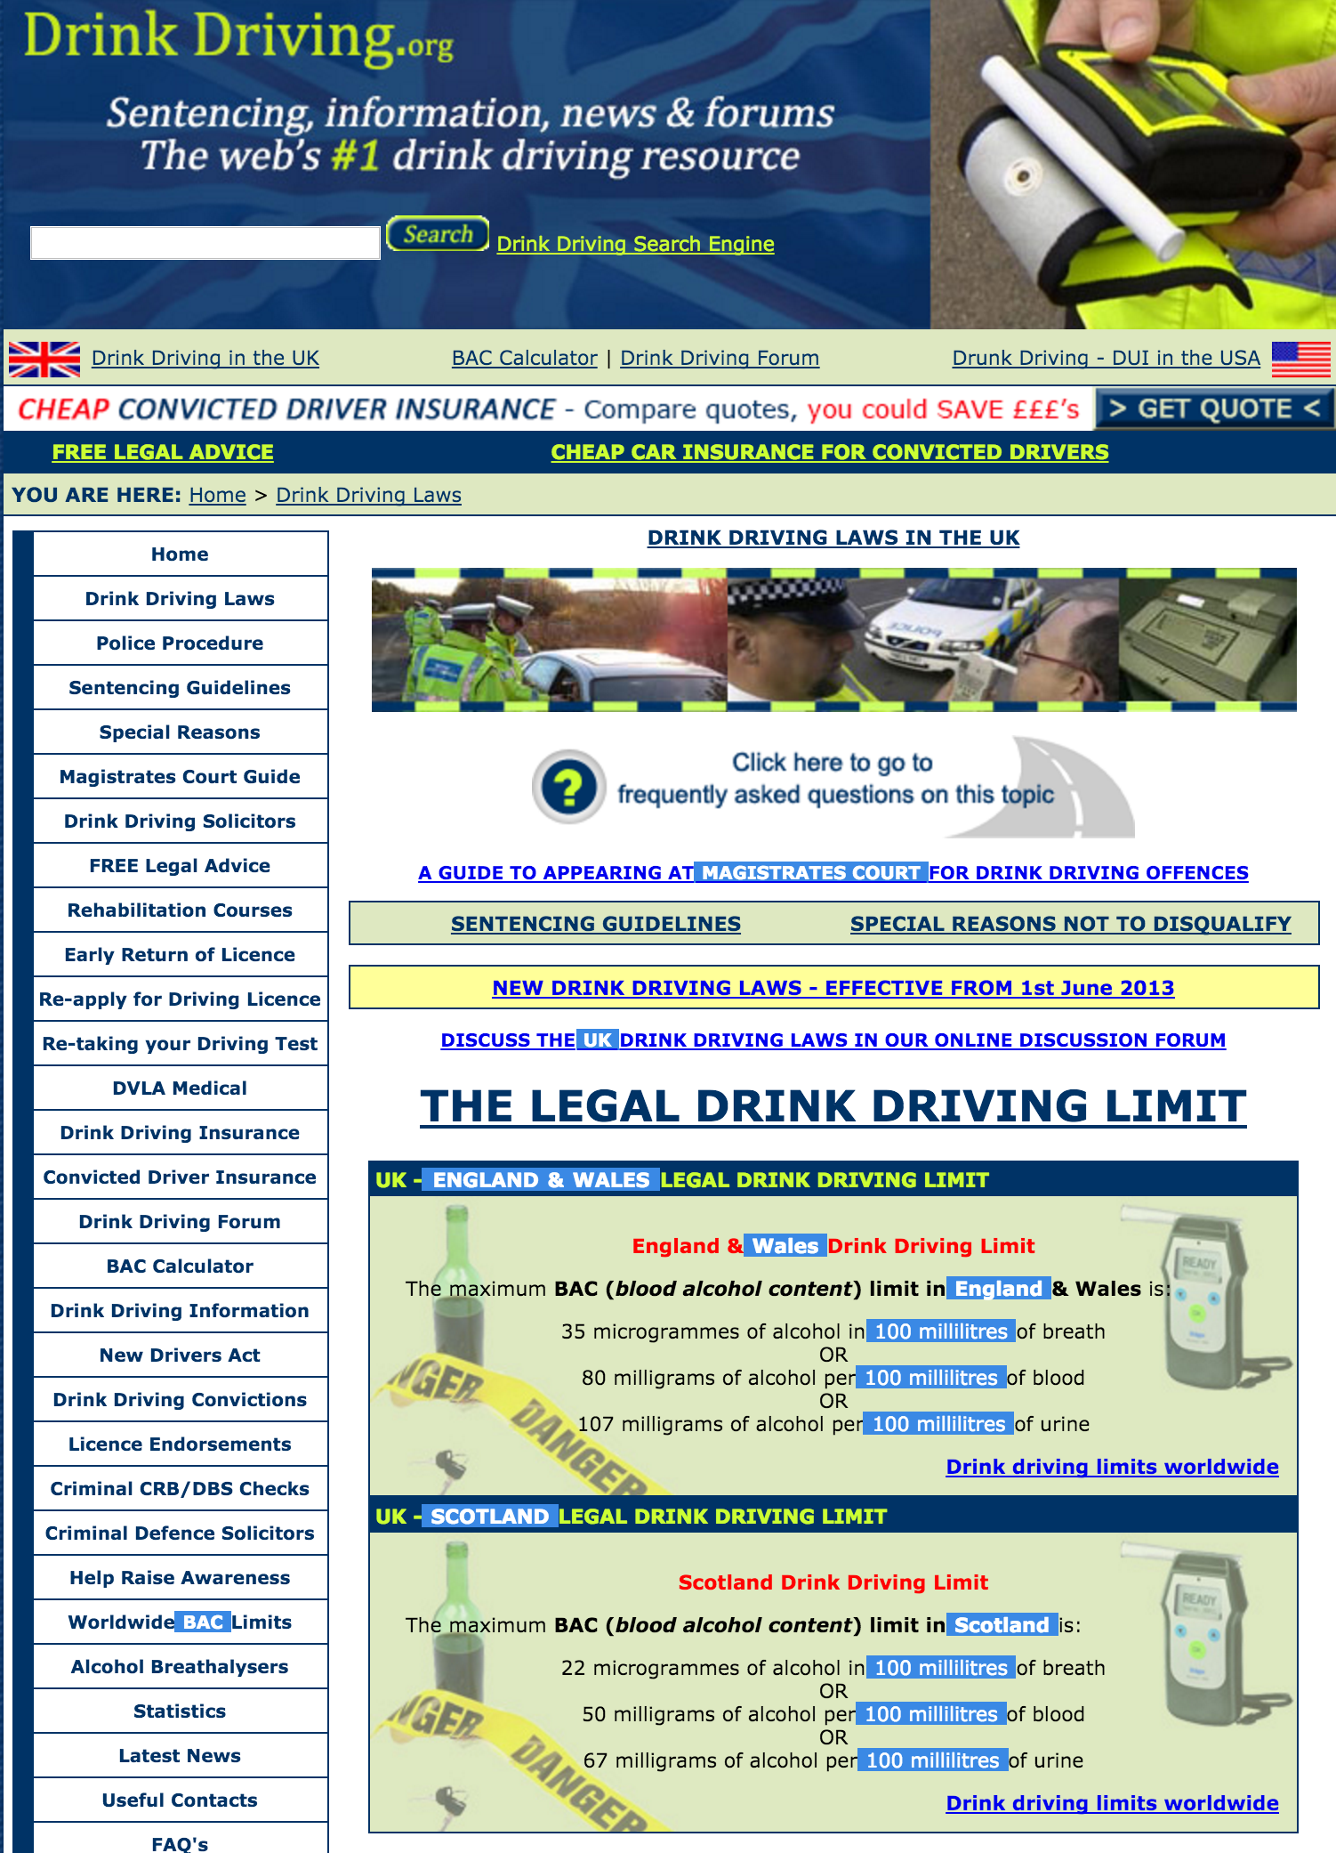
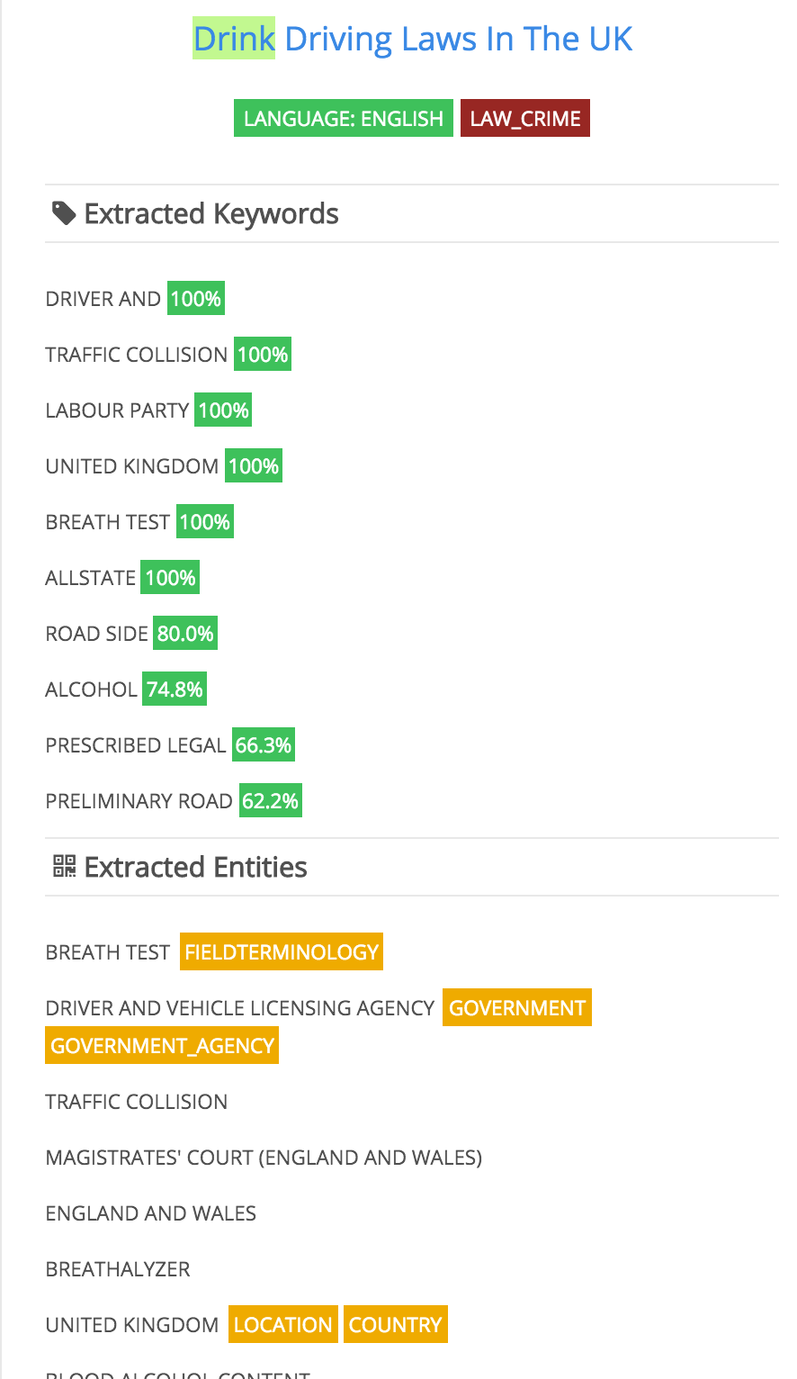
Semantic Social News Aggregation | SNARC
Enabling Self-service Data Provisioning Through Semantic Enrichment of Data

Slide 44
Proposed Framework
Dataset Maintenance & Discovery
HDL
Roomba
Dataset Quality
Dataset Integration and Enrichment
RUBIX
SNARC
Enabling Self-service Data Provisioning Through Semantic Enrichment of Data

Slide 45
Revisit: Use-case Scenario
Dan receives a memo from his management to create a report comparing the number of car accidents that occurred in France for this year, to its counterpart in the United Kingdom (UK).
Dan asked to highlight accidents related to illegal consumption of alcohol in both countries.
Enabling Self-service Data Provisioning Through Semantic Enrichment of Data

Slide 46
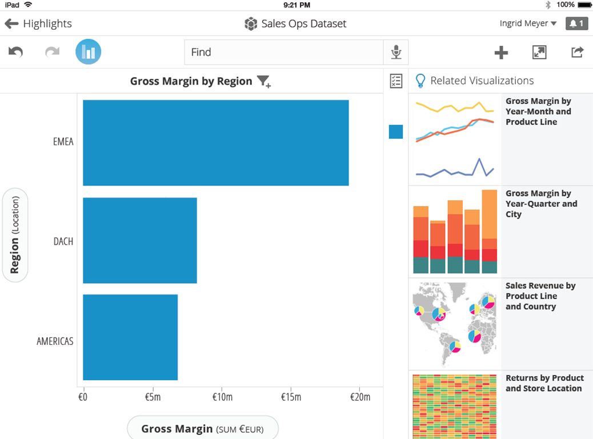

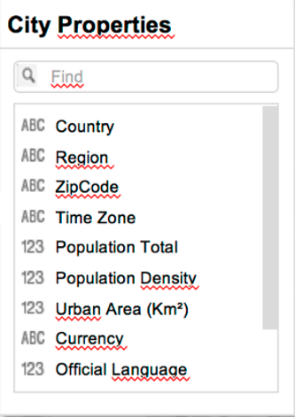


Dan Ferry
Roomba Data Quality Extension
Driving accidents alcohol
Accidents Cost by Region
Related Datasets
X
Transportation Accidents by Mode
Road traffic accidents involving alcohol (% of all traffic crashes)
Bureau of Transportation Statistics
Glasgow
Transportation – Accident – Car – Bus – Motorcycle – UK – London – AC991
World Health Organization
Alcohol – Drink – Car – Transportation Method , Accident
Roomba
Temporal coverage: From 2013 – To:2015
Geographical coverage: Greater London, UK
License: Creative Commons CC0 link
Commercial use, private use, modify, distribute
Use trademark, hold liable, use patent claims
More +
Drunk driving in the United States
Wikipedia
Alcohol – United States – Drunk - Driving
LDN
Transportation Accidents by Mode
Bureau of Transportation Statistics
Transportation – Accident – Car – Bus - Motorcycle
Harmonized Dataset Model (HDL)
Alcohol Beverage Sampling Program
Department of the Treasury
Alcohol – Beverage – Wine - Spirits
Manchester
@datagovuk | new data published, road accidents in middlands http://bit.ly/qwe1k
Source: Twitter
Semantic Social News Aggregation (SNARC)

Slide 47
Future Work | Data Profile Representation
[S] HDL as an ontology
[S] Extend HDL with a set of enumerations as values to ensure a unified fine-grained representation of a dataset
[M] Evaluate the usage of HDL in data portals and their effect on data portal traffic, number of downloads, number of datasets published, social popularity, etc.
Enabling Self-service Data Provisioning Through Semantic Enrichment of Data

Slide 48
[S] Roomba support to other data portal types like DKAN or Socrata
[M] Integrating statistical and topical profilers to allow generation of full comprehensive profiles
[M] Add the ability to correct the rest of the metadata either automatically or through intuitive manually-driven interfaces
[M] Investigate various resource sampling techniques for profiling purposes (random, weighted, centrality)
Future Work | Automatic Dataset Profiling
Enabling Self-service Data Provisioning Through Semantic Enrichment of Data

Slide 49
Future Work | Objective Linked Data Quality
[M] Integrate tools assessing models quality in addition to syntactic checkers
[M] Suggest weights to those indicators which will result in a more objective quality calculation process
[L] Monitor the evolution of datasets quality (indicators and measures)
Enabling Self-service Data Provisioning Through Semantic Enrichment of Data

Slide 50
Future Work | Enterprise Data Integration
[S] Integrating additional linked open data sources of semantic types such as YAGO
[S] Reverse engineer other knowledge graphs like Bing and compare the various results
[M] Evaluate our matching results against instance-based ontology alignment benchmarks
[L] Better evaluation of SNARC as a I) dataset search tool over social media II) social ranking tool for datasets popularity
Enabling Self-service Data Provisioning Through Semantic Enrichment of Data

Slide 51
Publications
Journals
Ahmad Assaf, Raphaël Troncy and Aline Senart: Towards An Objective Assessment Framework for Linked Data Quality. International Journal On Semantic Web and Information Systems, Minor revision, 2015
Conference Demo, Poster and Challenges
Ahmad Assaf, Raphaël Troncy and Aline Senart: Automatic Validation, Correction and Generation of Dataset Metadata - Enhancing Dataset Search and Spam Detection. In 24th International World Wide Web Conference (WWW 2015), Demo Track, May 2015, Florence, Italy
Ahmad Assaf, Ghislain Atemezing, Raphaël Troncy and Elena Cabrio: What are the important properties of an entity? Comparing users and knowledge graph point of view. In 11th Extended Semantic Web Conference (ESWC 2014), Demo Track, May 2014, Heraklion, Crete
Ahmad Assaf, Aline Senart and Raphaël Troncy: SNARC - An Approach for Aggregating and Recommending Contextualized Social Content. In 10th Extended Semantic Web Conference (ESWC 2013), Sattelite Events, May 2013, Montpellier, France.
1st Prize Winner of the AI Mashup Challenge
Enabling Self-service Data Provisioning Through Semantic Enrichment of Data

Slide 52
Publications
Workshops
Ahmad Assaf, Raphaël Troncy and Aline Senart: What's up LOD Cloud - Observing The State of Linked Open Data Cloud Metadata. In 2nd Workshop on Linked Data Quality (LDQ), May 2015, Portoroz, Slovenia
Best paper award
Ahmad Assaf, Raphaël Troncy and Aline Senart: HDL - Towards A Harmonized Dataset Model for Open Data Portals. In 2nd International Workshop on Dataset PROFIling & fEderated Search for Linked Data (PROFILES), May 2015, Portoroz, Slovenia
Ahmad Assaf, Raphaël Troncy and Aline Senart: An Extensible Framework to Validate and Build Dataset Profiles. In 2nd International Workshop on Dataset PROFIling & fEderated Search for Linked Data (PROFILES), May 2015, Portoroz, Slovenia.
Best paper award
Ahmad Assaf, Aline Senart and Raphaël Troncy: Data Quality Principles in the Semantic Web. In International Workshop on Data Quality Management and Semantic Technologies (DQMST), July 2012, Palermo, Italy
Ahmad Assaf, Eldad Louw, Aline Senart, Corentin Follenfant Raphaël Troncy and David Trastour: RUBIX: a Framework for Improving Data Integration with Linked Data. In 1st International Workshop on Open Data (WOD), June 2012, Nantes, France.
Enabling Self-service Data Provisioning Through Semantic Enrichment of Data

Slide 53
References
Annika Flemming. Quality Characteristics of Linked Data Publishing Datasources. Master's thesis, Humboldt-Universitt zu Berlin, 2010
Amrapali Zaveri, Anisa Rula, Andrea Maurino, Ricardo Pietrobon, Jens Lehmann, and Soren Auer. Quality Assessment Methodologies for Linked Open Data. Semantic Web Journal, 2012
Tim Berners-Lee. Linked Data - Design Issues. W3C Personal Notes, 2006 http://www.w3.org/DesignIssues/LinkedData
Dimitris Kontokostas, Patrick Westphal, Soren Auer, Sebastian Hellmann, Jens Lehmann, Roland Cornelissen, and Amrapali Zaveri. Test-driven Evaluation of Linked Data Quality. In 23rd International Conference on World Wide Web (WWW'14), 2014
Edna Ruckhaus, Oriana Baldizan, and Maria-Esther Vidal. Analyzing Linked Data Quality with LiQuate. In 11th European Semantic Web Conference (ESWC), 2014
Didier Cherix, Ricardo Usbeck, Andreas Both, and Jens Lehmann. CROCUS: Cluster-based ontology data cleansing. In 2nd International Workshop on Semantic Web Enterprise Adoption and Best Practice, 2014
Ziawasch Abedjan, Tony Gruetze, Anja Jentzsch, and Felix Naumann. Profiling and mining RDF data with ProLOD++. In 30th IEEE International Conference on Data Engineering (ICDE)
Eetu Makela. Aether - Generating and Viewing Extended VoID Statistical Descriptions of RDF Datasets. In 11th European Semantic Web Conference (ESWC), Demo Track, Heraklion, Greece, 2014
Christoph Bohm, Gjergji Kasneci, and Felix Naumann. Latent Topics in Graph structured Data. In 21st ACM International Conference on Information and Knowledge Management (CIKM)
Besnik Fetahu, Stefan Dietze, Bernardo Pereira Nunes, Marco Antonio Casanova, Davide Taibi, and Wolfgang Nejdl. A Scalable Approach for Efficiently Generating Structured Dataset Topic Profiles. In 11th European Semantic Web Conference (ESWC), 2014
Enabling Self-service Data Provisioning Through Semantic Enrichment of Data
Notes:
Flemming 2010
Zaveri 2012
Berners-Lee 2006
Kontokostas 2014
Ruckhaus 2014
Cherix 2014

Slide 54
THANK YOU
Ahmad Assaf
http://ahmadassaf.com/
@ahmadaassaf
http://github.com/ahmadassaf
Enabling Self-service Data Provisioning Through Semantic Enrichment of Data
Enabling Self-service Data Provisioning Through Semantic Enrichment of Data

Slide 55
Future Work
Lots of data spread over the web (structured, unstructured)
Wikipedia tables, HTML tables
Semantic interoperability
Extracting structured information
Life expectancy for data is shortened and quickly replaced by new data
Coping with data dynamicity
Enabling Self-service Data Provisioning Through Semantic Enrichment of Data
Notes:
Wikipedia tables, tons of data spread over the web .. Html tables .. E.g. Wikipedia .. Semantic interoperability (integration) -> understanding all these tables, what they talk about .. Extracting structured data out of them
More and ore data is published .. Life expectancy for data is shortened and quickly replaced by new data ->
Understand small scale data like tables and integrate/aggregate them
Coping with the dynamicity of data (weighted quality)

Slide 56
Data Portal Identification | step (I)
Roomba is extensible to any data portal exposing its functionalities via an external accessible API
This process is important in order to identify the underlying data model
We apply various methods for the portal identification process:
URL inspection
Meta tags inspection
Document Object Model (DOM) inspection
API query
Enabling Self-service Data Provisioning Through Semantic Enrichment of Data

Slide 57
Metadata, Instance and Resource Extraction | steps (II, III)
The metadata should contain information about the resources associated with the dataset
Before extracting the resource instance(s), Roomba performs:
Resource metadata validation: Checking the HTTP request HEAD information
Format Validation: Validate resource formats against a linter or a validator e.g. node-csv for CSV files or n3 for N3 and Turtle RDF serializations
Enabling Self-service Data Provisioning Through Semantic Enrichment of Data

Slide 58
Instance and Resource Extraction – Sampling | step (III)
Certain datasets contain large amounts of resources.
A sampler method is introduced to execute various strategies:
Random Sampling: Randomly select resources
Weighted Sampling: resource datatype properties over the maximum number of datatype properties of all dataset resources.
Resource Centrality Sampling: resource types over the total number of resources types in the dataset
Enabling Self-service Data Provisioning Through Semantic Enrichment of Data
Notes:
complex and open problem
add to the perspectives

Slide 59
Metadata Validation | step (IV)
The validation process identifies missing or incorrect information and tries to automatically correct them when possible.
The validation is measured against the standard dataset model of the underlying data portal
There exist special validation steps for some fields e.g. emails, urls
We use the HTTP request header information to fix various fields automatically
Enabling Self-service Data Provisioning Through Semantic Enrichment of Data

Slide 60
LOD Cloud State | Metadata Errors for Information Groups
41% of ownership information is missing or undefined
Resources have the poorest metadata health across information groups
64% general metadata
100% access metadata
80% provenance metadata
Enabling Self-service Data Provisioning Through Semantic Enrichment of Data
Notes:
With roomba we have new insights / qunaitfy what was felt about th equality of LOD
We can also measure improvmenets / evolves with time

Slide 61
LOD Cloud State | Top Metadata Errors
25% of the datasets access information are not clean [unavailability mainly]
68% of the resources access data can be fixed automatically
31.27% of the resources were not reachable
63.17% of the resources don’t have valid resource_type
Creating an aggregate report for resources > format:title
62.16% of the datasets have defined SPARQL endpoints using the api/sparql resource format
92.27% provided RDF example links
56.3% provided direct links to downloadable RDF dumps
Enabling Self-service Data Provisioning Through Semantic Enrichment of Data
Notes:
top errors and top imporvements

Slide 62
LOD Cloud State | Metadata File Types Errors
Enabling Self-service Data Provisioning Through Semantic Enrichment of Data
Notes:
211 (63.17%) resources do not have valid resource_type , 112 (33.53%) are files,
8 (2.39%) a re metadata and one (0.029%) are example and documentation types

Slide 63
LOD Cloud State | Metadata Errors
Noisiest part of the access metadata is license information
16.6% of the datasets don’t have license_title and license_id
54.44% datasets don’t have license_url
51.35% don’t have maintainer
55.21% of the datasets are missing maintainer_email | 15.06% author_email
80% of the provenance information is missing or undefined
The only manual field in provenance information version is missing from 60.23% of the datasets
Enabling Self-service Data Provisioning Through Semantic Enrichment of Data

Slide 64
Manual Reporting
Data portal administrators need an overall knowledge of the datasets and their properties
Roomba allows generation of numerous reports driven by manually entered formatted queries
Meta-field aggregation values e.g. resources>resource_type
Key:object meta-field values: resources>resource_type:resources>name
Empty field values
Enabling Self-service Data Provisioning Through Semantic Enrichment of Data

Slide 65
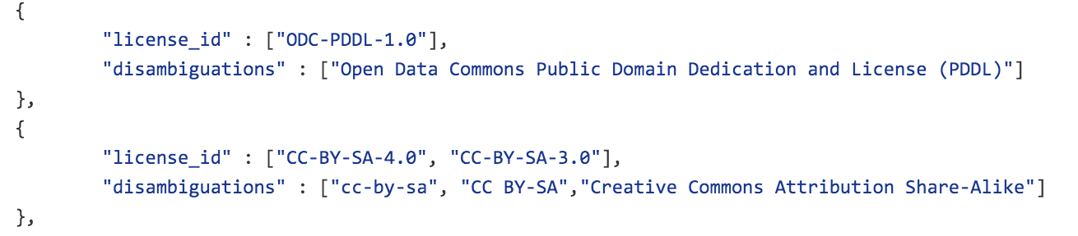
Metadata Validation – License Information
From our experiments, license information were particularly noisy and not standardized e.g. CCZero, CC0
We manually created a license mappings file standardizing the license ID, title and url from the Open Licenses knowledge base
https://github.com/ahmadassaf/opendata-checker/blob/master/util/licenseMappings.json
Enabling Self-service Data Provisioning Through Semantic Enrichment of Data

Slide 66
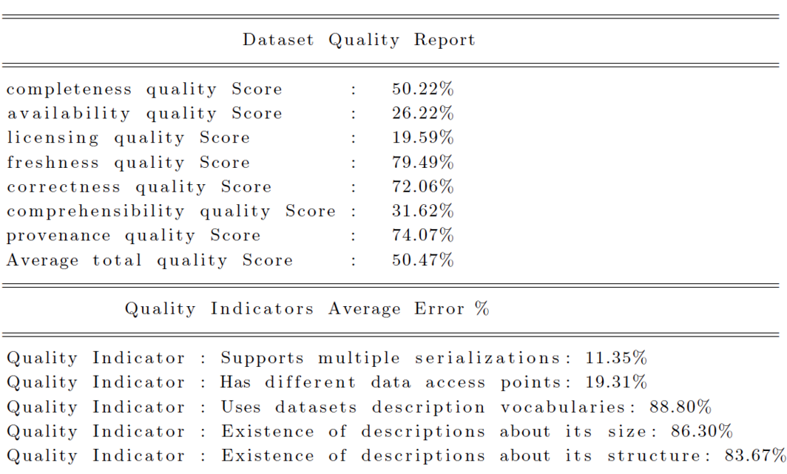
Experiments & Evaluation – Report Sample | LOD Cloud
Enabling Self-service Data Provisioning Through Semantic Enrichment of Data

Slide 67
Objective Data Quality Assessment
Data quality assessment is the process of evaluating if a piece of data meets the consumers need in a specific use case
In [Zaveri 2012] lots of the defined quality dimensions are not objective e.g., like low latency, high throughput or scalability
In addition, there were some missing objective indicators vital to the quality of LOD e.g., indication of the openness of the dataset
We propose an objective framework to evaluate the quality of Linked Data sources.
Enabling Self-service Data Provisioning Through Semantic Enrichment of Data
Notes:
Flemming 2010
Zaveri 2012
Berners-Lee 2006
Kontokostas 2014
Ruckhaus 2014
Cherix 2014

Slide 68
Objective Data Quality Assessment Tools
Large amount of those indicators can be examined automatically from attached datasets metadata found in data portals [Kontokostas 2014, Ruckhaus 2014, Cherix 2014]
Extensive survey on Linked Data quality tools
Lack in automatic tools to check the dataset quality especially in its completeness, licensing and provenance measures
34 quality indicators are related to the entities and models quality and cannot be checked through the attached metadata
Excluding security related quality indicators the Roomba quality extension is able to assess and score 23 of them (82%)
Enabling Self-service Data Provisioning Through Semantic Enrichment of Data

Slide 69


Semantic Social News Aggregation | SNARC
Categories: Culture_Politics, Regional and Society
Keywords: Taksim Square, Protesters, Gezi Park, Mr Erdogan, Istanbul
Entities : Gezi Park, Recep Tayyip Erdogan, Taksim Square, Justice and Development Party (Turkey), Police of Turkey
Enabling Self-service Data Provisioning Through Semantic Enrichment of Data

